Slide 1

Operators

Slide 2
Operators
Operators are symbol that is used to perform mathematical or logical manipulations.
Python programming language is rich with built-in operators.
Types of operator:
Arithmetic Operators
Assignment Operators
Comparison (Relational) Operators
Logical Operators
Identity Operators
Bitwise Operators
Membership Operators

Slide 3
Arithmetic Operator
+ Addition
- Subtraction
* Multiplication
/ Division
% Modules
** Exponent
// Floor Division

Slide 4
Assignment Operator
Assignment operators are used in Python to assign values to variables.
Operator | Example | Equivalent to
= | x = 5 | x = 5
+= | x += 5 | x = x + 5
-= | x -= 5 | x = x - 5
*= | x *= 5 | x = x * 5
/= | x /= 5 | x = x / 5
%= | x %= 5 | x = x % 5
//= | x //= 5 | x = x // 5
**= | x **= 5 | x = x ** 5

Slide 5
Comparison Operator
Comparison operators are used to compare values. It either returns True or False according to the condition.
Symbol | Operator Name | Description
== | Double Equal | If the two value of its operands are equal, then the condition becomes true, otherwise false
!= | Not Equal To | If two operands values are not equal, then condition becomes true. Both the operators defines the same meaning and function
> | Greater Than | If the value of left hand operand is greater than the value of right hand operand, condition becomes true.
< | Less Than | If the value of left hand operand is less than the value of right operand, then condition becomes true.
<= | Less Than Equal To | If the value of left hand operand is less than or equal to the value of right hand operand, condition becomes true.
>= | Greater Than Equal To | If the value of left hand operand is greater than or equal to the value of right hand operand, condition becomes true.

Slide 6
Logical Operator
Symbol | Operator Name
and | Logical AND
or | Logical OR
not | Logical NOT

Slide 7
Identity Operator
Symbol | Operator Name | Description
is | is | The result becomes true, if values on either side of the operator points to the same object & False otherwise.
is not | is not | The result becomes False if the variables on either side of the operator points to the same object

Slide 8
Bitwise Operator
Operator | Meaning
& | Bitwise AND
| | Bitwise OR
~ | Bitwise NOT
^ | Bitwise XOR
>> | Bitwise right shift
<< | Bitwise left shift

Slide 9
Membership Operators
Operator | Meaning
in | True if value/variable is found in the sequence
not in | True if value/variable is not found in the sequence

Slide 10
Python Input / Output
Python provide built-in function for I/O.
For Input : In Python, we have input() function to take a input from user.
The syntax for input() is :
input([prompt])
For Output : We use the print() function to output data to the standard output device (screen).
For Example :
num=input(“Enter Number : “)
print(“Value of num is”,num)

Slide 11
Flow Control

Slide 12
Flow Control
Python provide various tools for flow control.
Some of them are :
if statement
if-else statement
if .. elif … else statement
while
for
pass
break
continue etc.

Slide 13
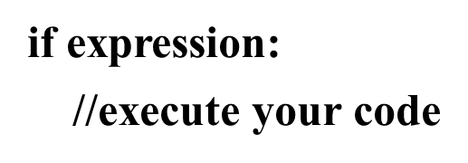
if statement
An if statement in python takes an expression with it. If the expression amounts to True, then the block of statements under it is executed. If it amounts to False, then the block is skipped and control transfers to the statements after the block.
Syntax:
But remember to indent the statements in a block equally. This is because we don’t use curly braces to delimit blocks. Also, use a colon(:) after the condition.

Slide 14
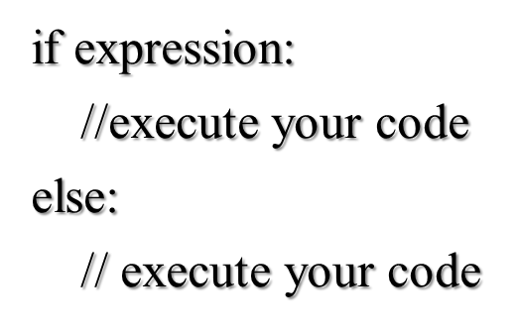
if-else statement
When we want to execute some block of code if a condition is true and another block when the condition is false, In such case we use if-else statement.
Syntax:

Slide 15
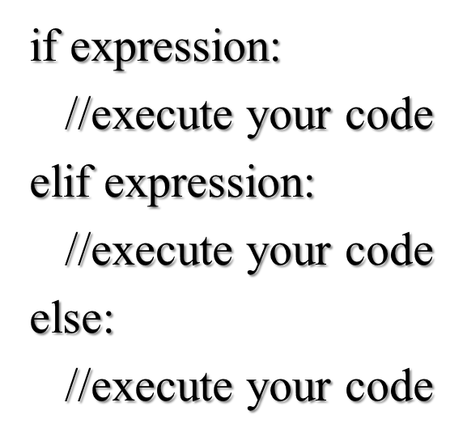
if….elif…else statement
There is no switch statement in Python. You can use an if…elif…else statement to do the same thing.
The elif statement allows you to check multiple expressions for truth value and execute a block of code as soon as one of the conditions evaluate to true
Syntax :

Slide 16
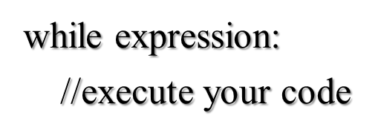
while Loop
The while statement allows you to repeatedly execute a block of statements as long as a condition is true.
Indentation and colon should be respected
Syntax:

Slide 17
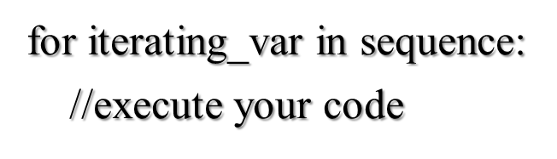
for Loop
The for…in statement is another looping statement which iterates over a sequence of objects i.e. go through each item in a sequence.
Syntax:

Slide 18
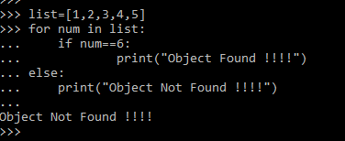
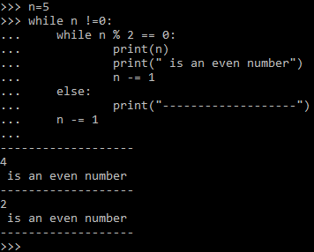
Loops With else Clause
Python supports to have an else statement associated with a loop statement.
If the else statement is used with a for loop, the else statement is executed when the loop has exhausted iterating the list.
If the else statement is used with a while loop, the else statement is executed when the condition became false.

Slide 19
Range Function
range() generates lists containing arithmetic progression
3 variation of range() function :
range(stop) – Starts from 0 till (stop -1)
range(start,stop) – Ends at (stop -1)
range(start,stop,step) – Step can not be 0, default is 1

Slide 20
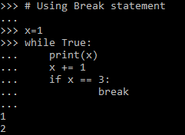
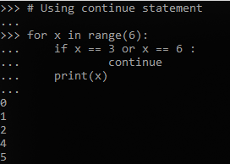
Break and Continue Statement
The break statement is used to break out of a loop statement i.e. stop the execution of a looping statement, even if the loop condition has not become false or the sequence of items has not been completely iterated over.
The continue statement is used to tell Python to skip the rest of the statements in the current loop block and to continue to the next iteration of the loop.

Slide 21
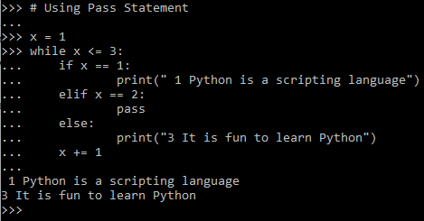
Pass Statement
The pass statement does noting. It can be used when a statement is required syntactically but the program required no action
In simpler words, you cannot leave a statement empty in python. In this situation you can place pass statement there
Used commonly while creating minimal classes.
Syntax:
While True:
pass
Class MyEmptyClass:
pass

Slide 22
THANK YOU!!
visit : www.rcplindia.in
santosh@rcplindia.in

